Slide 1
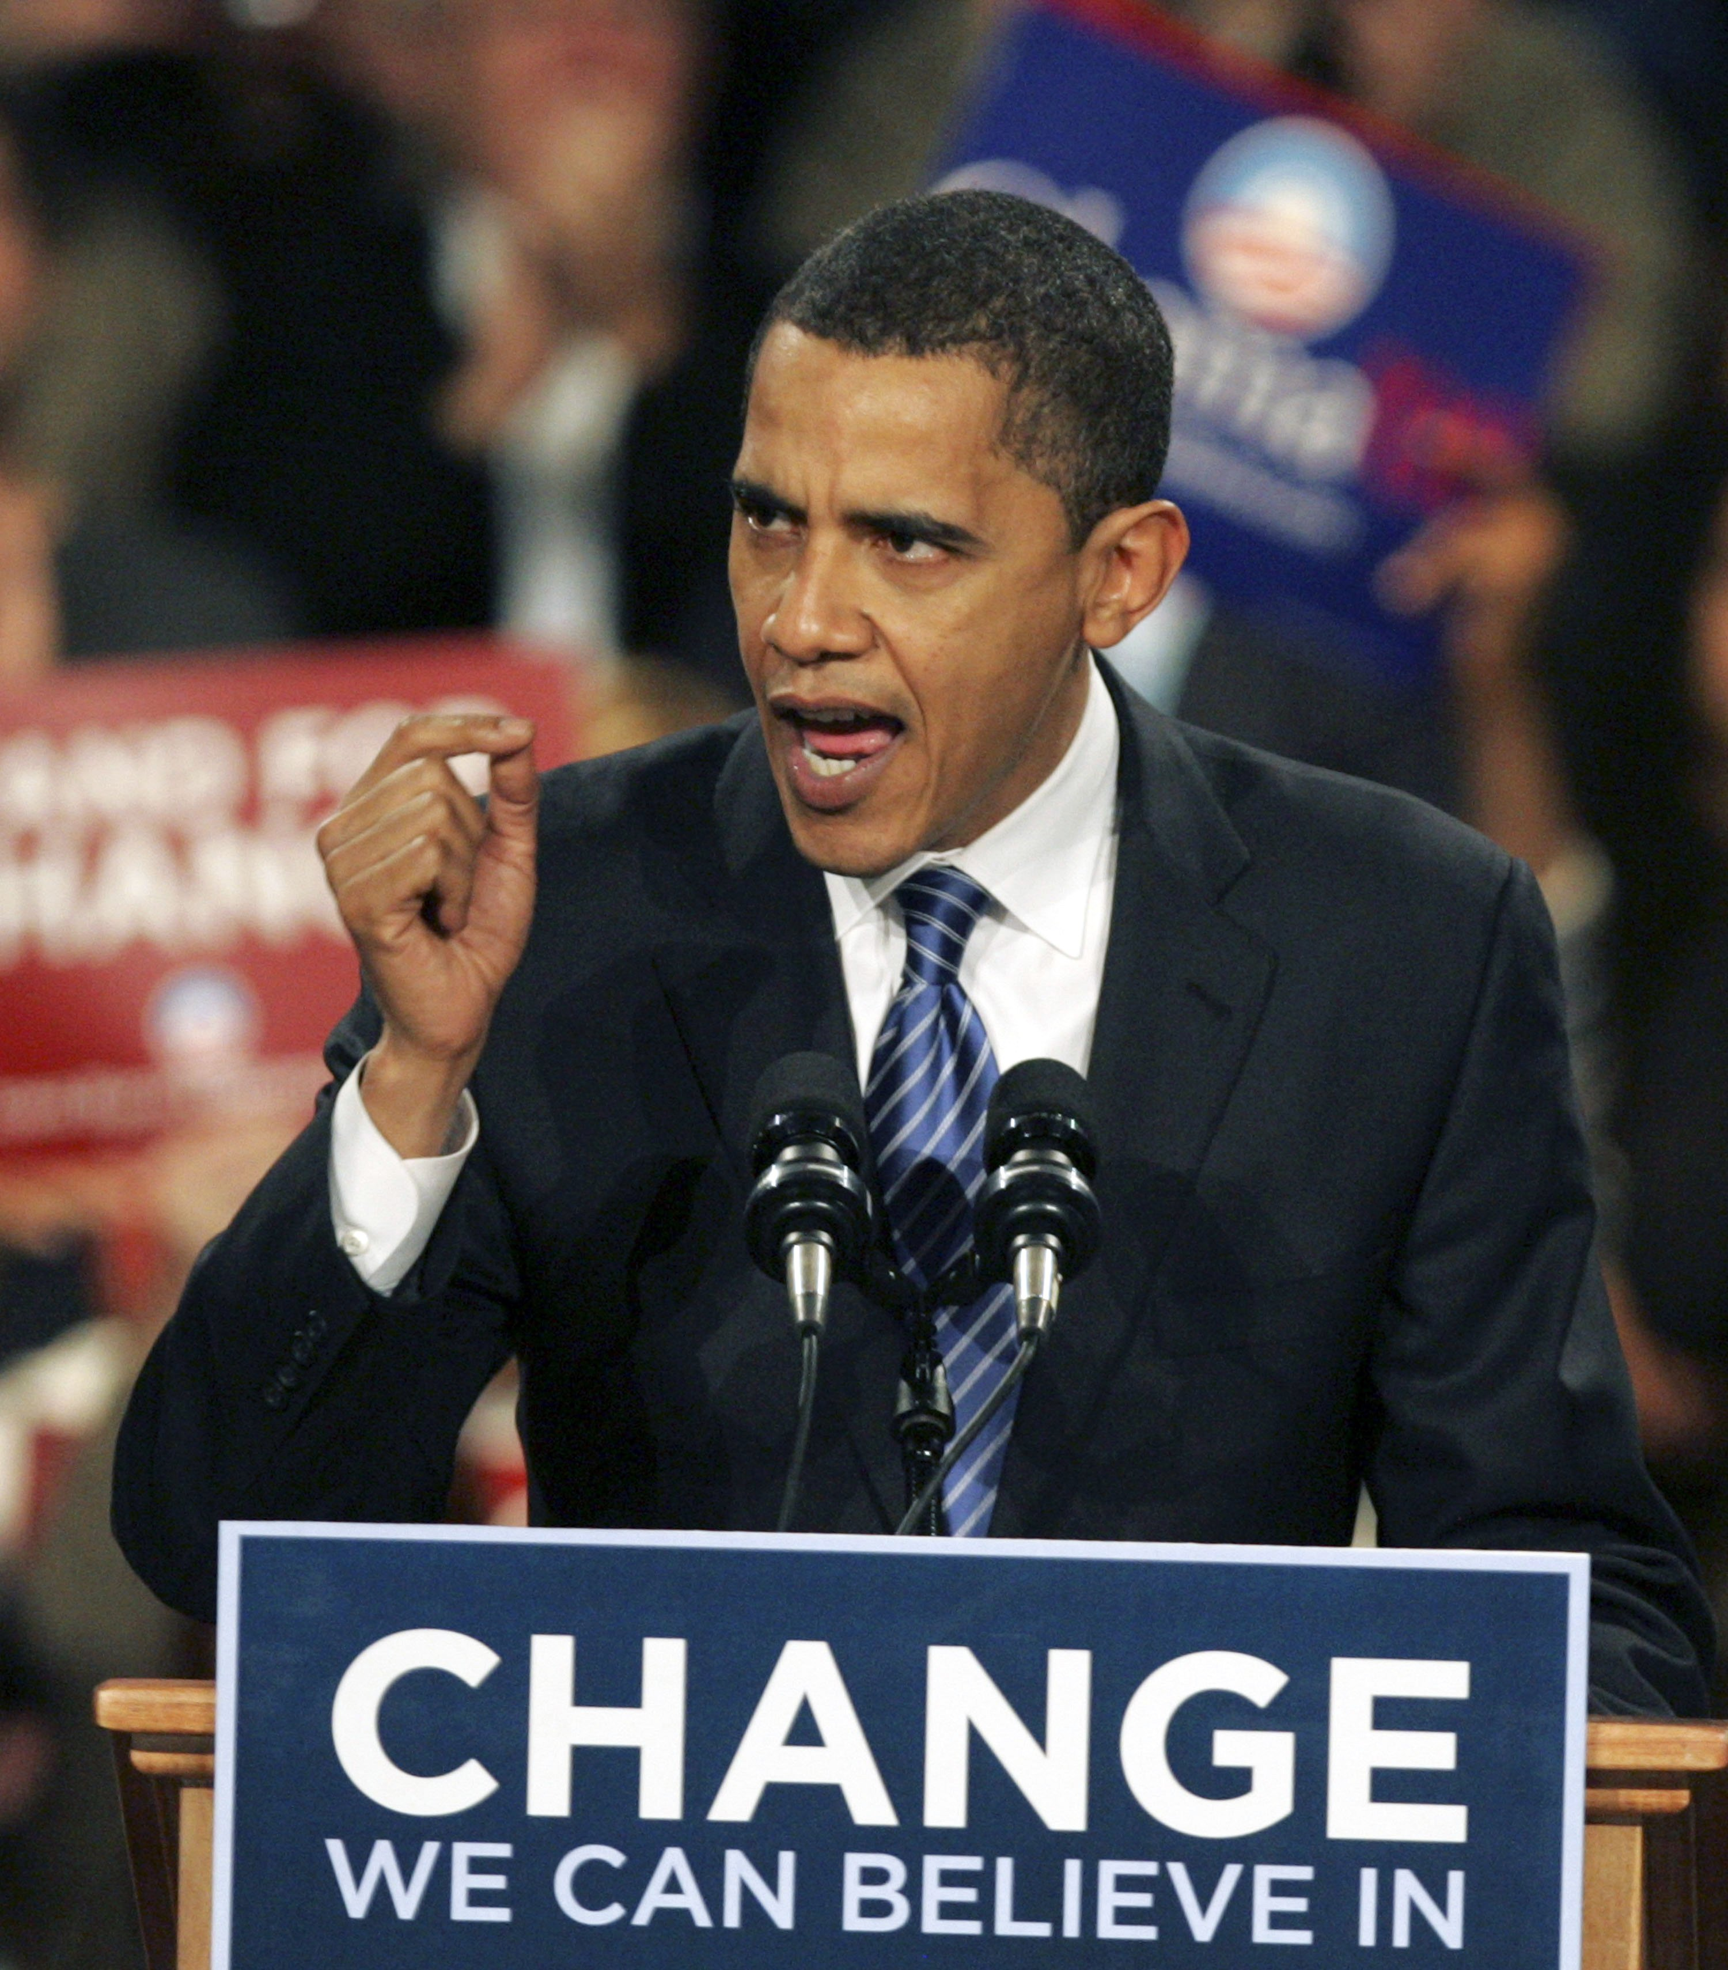
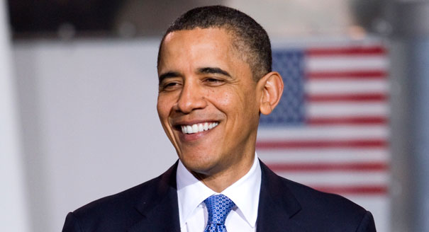
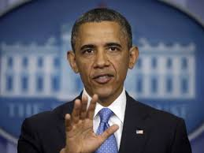
Presidential Session
Society for the Psychological Study of Culture, Ethnicity, and Race
Race/Ethnic Relations and the Obama Presidency Perspectives of Leaders in the Field
“The world doesn’t just revolve around you, you have to learn to see things
through other people’s eyes.” -- Barack Obama, 2007.
Identifying and Developing More Culturally Sensitive and Diverse Leadership Styles
Joseph E. Trimble
Center for Cross-Cultural Research
Department of Psychology
Western Washington University

Slide 2
US Presidents’ Perspectives on American Indians
Selected Quotations*
“Indians and wolves are both beasts of prey, tho’ they differ in shape.”
-- George Washington
“That those tribes cannot exist surrounded by our settlements and in continual contact with our citizens is certain. They have neither the intelligence, the industry, the moral habits, nor the desire of improvement which are essential to any favorable change in their condition. Established in the midst of another and a superior race, and without appreciating the causes of their inferiority or seeking to control them, they must necessarily yield to the force of circumstances and ere long disappear.”
-- Andrew Jackson
“I don’t go so far as to think that the only good Indians are dead Indians, but I believe nine out of ten are, and I shouldn’t like to inquire too closely into the case of the tenth.”
-- Theodore Roosevelt
*(Abstracted from nativenewsonline.net)

Slide 3
US Presidents’ Perspectives on American Indians-
Selected Quotations
“The United States, which would live on Christian principles with all of the peoples of the world, cannot omit a fair deal for its own Indian citizens.”
-- Harry Truman
“For a subject worked and reworked so often in novels, motion pictures, and television, American Indians remain probably the least understood and most misunderstood Americans of us all.”
-- John Kennedy
“I am committed to furthering the self-determination of Indian communities but without terminating the special relationship between the Federal Government and the Indian people. I am strongly opposed to termination.”
-- Gerald Ford
*(Abstracted from nativenewsonline.net)

Slide 4
US Presidents’ Perspectives on American Indians-
Selected Quotations
“Some (Indians) still prefer, however, that way – that early way of life. And we’ve done everything we can to meet their demands as to how they want to live. Maybe we made a mistake. Maybe we should not have humored them in that wanting to stay in that kind of primitive lifestyle. Maybe we should have said, no, come join us; be citizens along with the rest of us.”
-- Ronald Reagan
“Tribal sovereignty means that. It’s sovereign. You’re a… you’re a… you’ve been given sovereignty and you’re viewed as a sovereign entity.”
-- George W. Bush
“We also recommit to supporting tribal self-determination, security, and prosperity for all Native Americans. While we cannot erase the scourges or broken promises of our past, we will move ahead together in writing a new, brighter chapter in our joint history.”
-- Barack Obama
*(Abstracted from nativenewsonline.net)

Slide 5
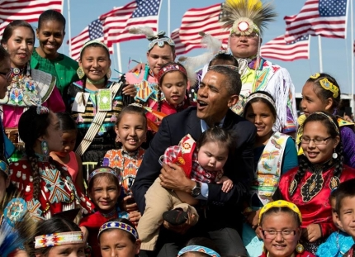
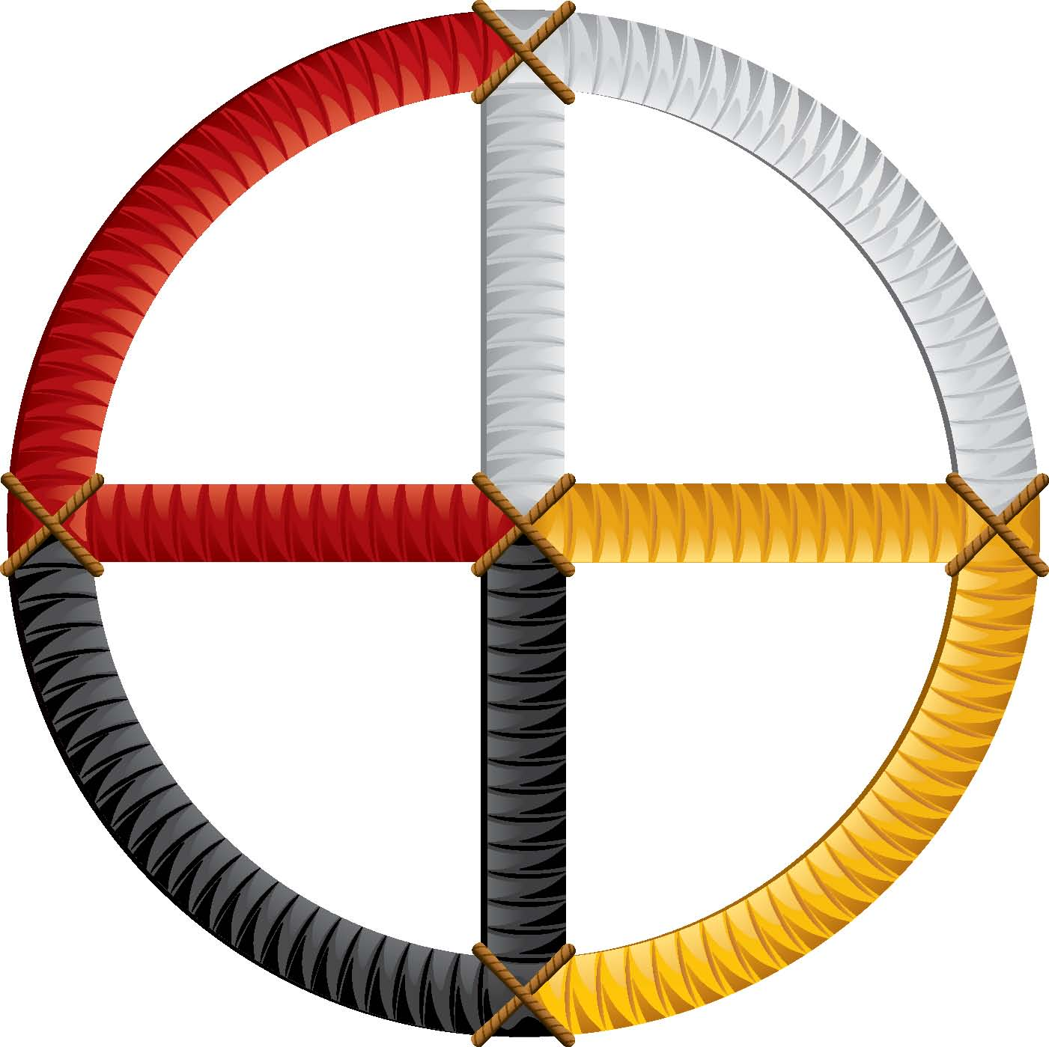
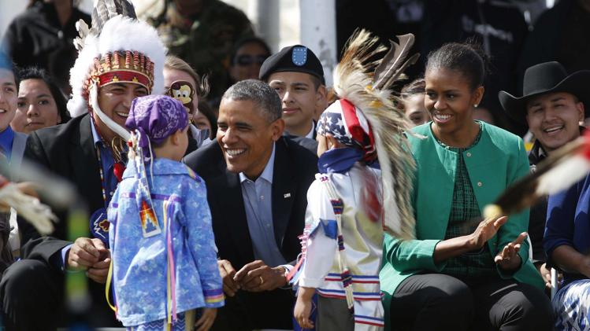
President Obama visits Standing Rock Reservation on June 12, 2015. It was the first visit by a sitting president to any reservation since 1999 and the third presidential visit overall in the nation's history.
"I know that throughout history, the United States often didn't give the nation-to-nation relationship the respect that it deserved," Obama said. "So I promised when I ran to be a president who'd change that — a president who honors our sacred trust, and who respects your sovereignty.” – President Obama

Slide 6
Bid farewell to the
Alpha Male
Leadership Style

Slide 7
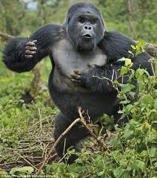
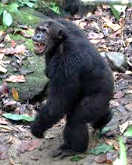
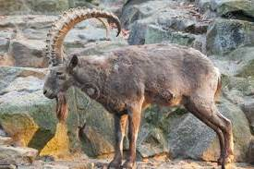
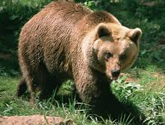
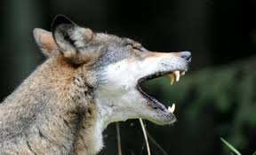
Insert
Your Favorite Alpha Male
Human
Here.

Slide 8
An Alpha Male Leader Can Be:
Bold
Domineering
Aggressive
Competitive
Decisive
Achievement- focused
Creative
Self-centered
Critical

Slide 9
Dimensions for Culturally Diverse Leadership Prototypes
Constructive
Imaginative
Principled
Synergistic
Virtuous

Slide 10
Rank Order of Important Leadership Characteristics
Most Important
Least Important
Adaptability
Integrity
Authentic
Honest
Communicator
Aggressive
Conflict-inducer
Dominant
Self-centered
Status conscious

Slide 11
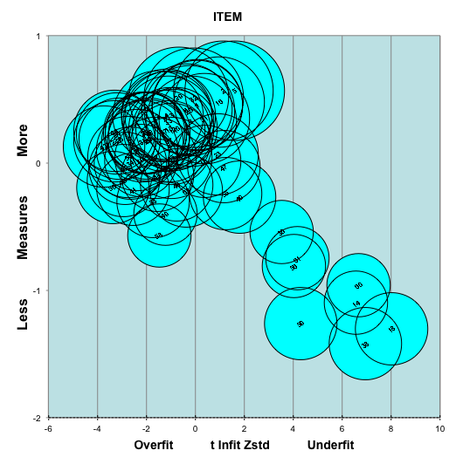
Rasch Leadership Item Fit Distribution Patterns

Slide 12
Rasch Leadership Item Rankings
for Survey Participants
Top 10 Ratings
Bottom 10 Ratings
Honest
Integrity
Adaptability
Self-Knowledge
Caring
Authentic
Compassionate
Communicator
Warmth
Motivating
Competitive
Emotionally Tough
Forceful
Submissive
Aggressive
Conflict Inducer
Indirect
Dominant
Celebrity
Self-Centered

Slide 13
Barack Obama’s Leadership Style Is:
Creative
Honest
Fair
Respectful
Value-centered
Sensitive
Achievement- focused
Creative
Self-confident
Engaging
Mindful

Slide 14
Who are you willing to follow?

Slide 15
What kind of leader are you going to be?

Slide 16
What could we have if we welcomed different leadership
styles?

